Slide 1


Stock Price Predictor
/

Slide 2

Problem Statement
The Stock market appears in the news everyday . The rate of investment and business opportunities in the stock market can increase with an efficient system . The main aim of this project is to predict future stock prices

Slide 3
About Stock Prediction App
The project aims at predicting stock market by using previous data and trends followed.
By analyzing closing price vs time graph.
By comparing data we can predict the market.
Easy User Interface

Slide 4
Numpy : Numpy is the fundamental package for scientific computing in Python. It is a Python library that provides a multidimensional array object, various derived objects (such as masked arrays and matrices), and an assortment of routines for fast operations on arrays, including mathematical, logical, shape manipulation, sorting, selecting, I/O, transforms, basic linear algebra, basic statistical operations, random simulation and much more
Pandas: Pandas is a Python library used for working with data sets . It has functions for analyzing, cleaning, exploring, and manipulating data. Pandas allows us to analyze big data and make conclusions based on statistical theories. Pandas can clean messy data sets, and make them readable and relevant . Relevant data is very important in data science.
MatPlotlib.pyplot: matplotlib.pyplot is a state-based interface to matplotlib. It provides an implicit, MATLAB-like, way of plotting. It also opens figures on your screen, and acts as the figure GUI manager.
pyplot is mainly intended for interactive plots and simple cases of programmatic plot generation

Slide 5
Streamlit :
Streamlit is an open source app framework in Python language. It helps us create web apps for data science and machine learning in a short time. It is compatible with major Python libraries such as scikit-learn, Keras, PyTorch, SymPy(latex), NumPy, pandas, Matplotlib etc. With Streamlit, no callbacks are needed since widgets are treated as variables. Data caching simplifies and speeds up computation pipelines. Streamlit watches for changes on updates of the linked Git repository and the application will be deployed automatically in the shared link

Slide 6
Technology Stack
Python 3.9.10
Streamlit 1.8.1
P
S
Yahoo Finance 0.1.7
Matplotlib 3.5.1
Y
M

Slide 7
ScreenGrab
5
Let’s film the captures

Slide 8
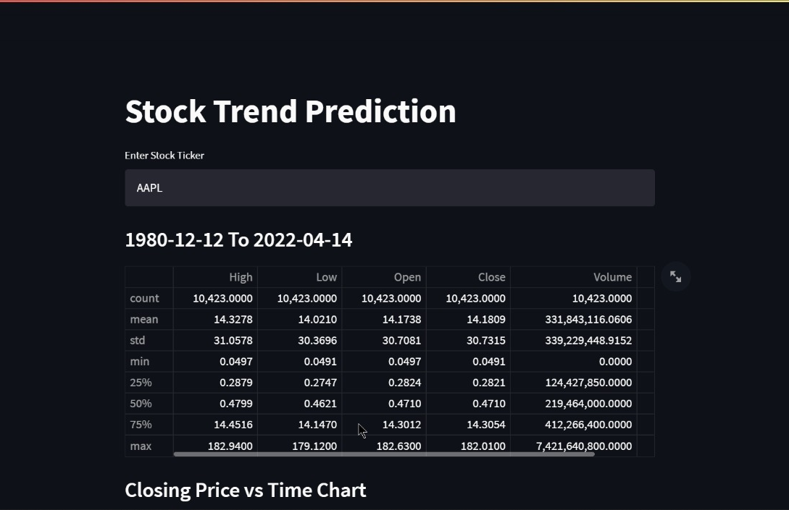
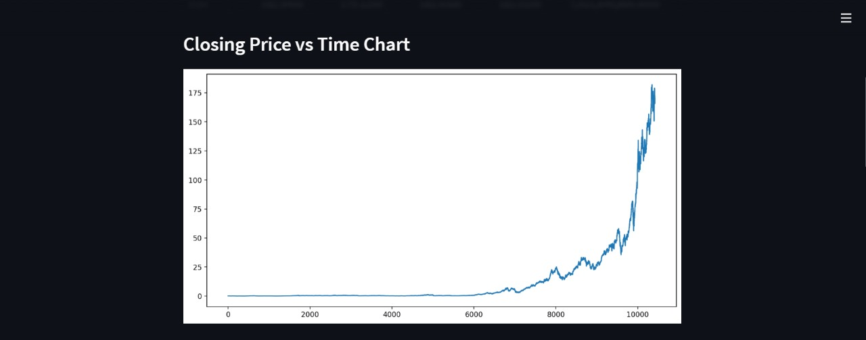

Slide 9
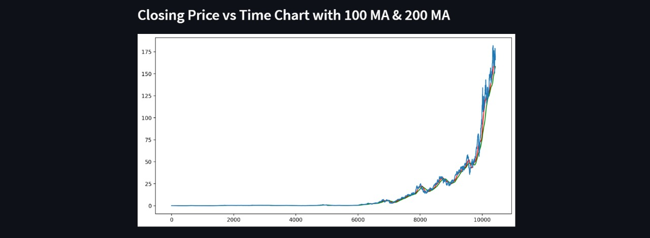
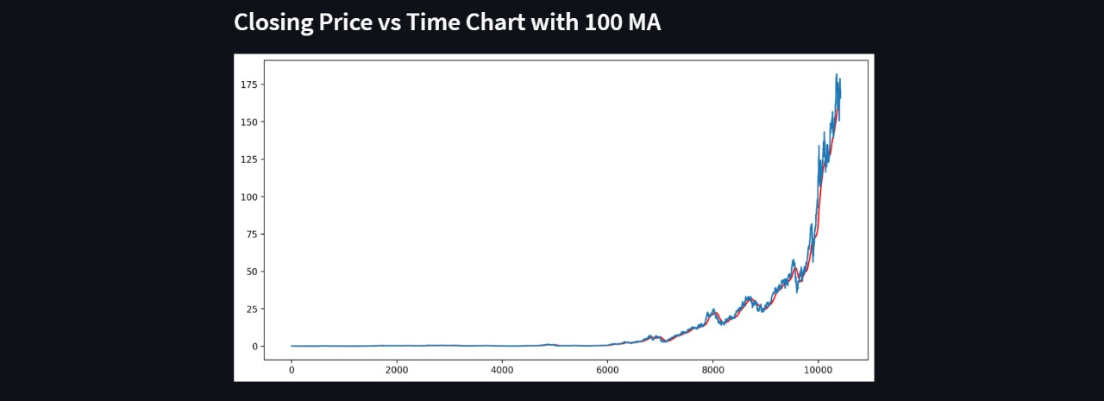

Slide 10
References
https://finance.yahoo.com/
https://matplotlib.org/3.5.0/api/_as_gen/matplotlib.pyplot.html
https://www.simplilearn.com/tutorials/machine-learning-tutorial/stock-price-prediction-using-machine-learning#:~:text=Stock%20Price%20Prediction%20using%20machine%20learning%20helps%20you%20discover%20the,a%20hard%20task%20to%20do.
https://streamlit.io/

Slide 11
Group Members:
Vibodh Bhosure – 20102A0032
Prajwal Vaidya – 20102A0051
Saarang More – 20102B0016
Guide: - Prakash Parmar Sir

